Slide 1


Electromagnetic Field Detector
By Tracy MacAulay-Higgan

Slide 2
Concept
I had the idea of creating a device to detect the amount of electromagnetic energy in a room and see what factors changed the levels. The device I have made contains multiple leds and they change colour, depending on the level of EMF in the area as the antennae is moved around.

Slide 3
Planning
I first had to work out what parts I needed and how I was going to get them. It turns out they were all easily accessible. I just had to solder some wires and I was organized.

Slide 4
Construction and issues
I had to work out how to wire up the board so it would actually work. I did find a diagram on line – maybe not the best idea because it didn’t actually work the way it should. And the sample code was no better.

Slide 5
Use Cases
This device can be used to detect levels of EMF in the area surrounding the antennae.
The numbers constantly change depending on the levels.
Once the sketch is running the numbers can be tracked either with a graph or values.
It is interesting to see what devices give off the most EMF.

Slide 6
Troubleshooting!
First I needed to double and triple check the wiring – I even had more eyes look at it and it seemed to be exactly as the diagram was shown.
Next was to look the sample code – if I could get this to work then I could make it my own by altering it, but there was something not right with this code.
Next was to make something simple work and go from there. What should have take and couple of days took over two weeks and led to panic.

Slide 7
More troubleshooting
I found some more ideas on line – learnings from this exercise is to look around lots before deciding on a final idea
https://www.instructables.com/Arduino-EMF-Detector/
This one use a 7 segment LED and might have actually worked.
Even though I (along with others) spent time searching for the answers I was not able to solve my problem, so my circuit is different.

Slide 8
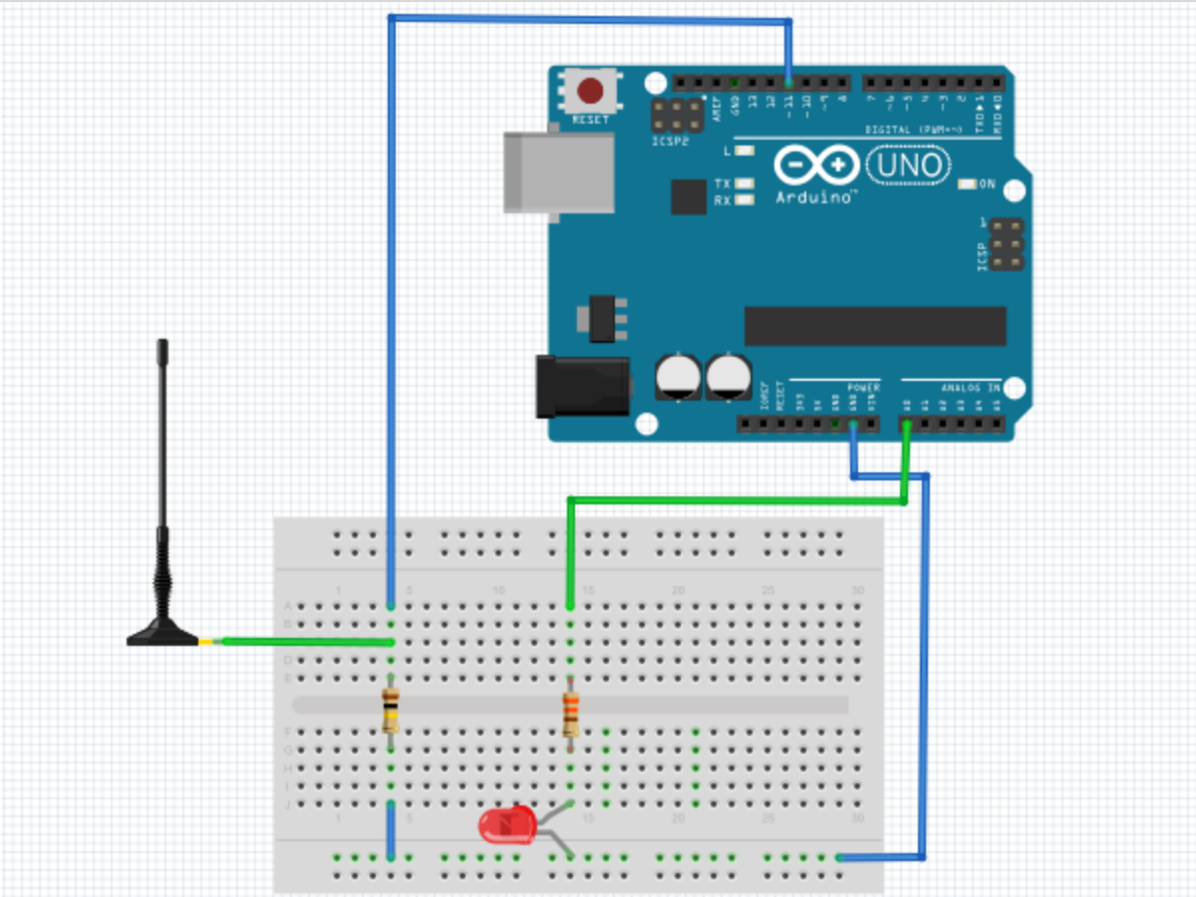
Diagram of the one I tried to make
https://www.hackster.io/justin1445/electromagnetic-field-detector-arduino-uno-a84148
Website I go this diagram from.

Slide 9
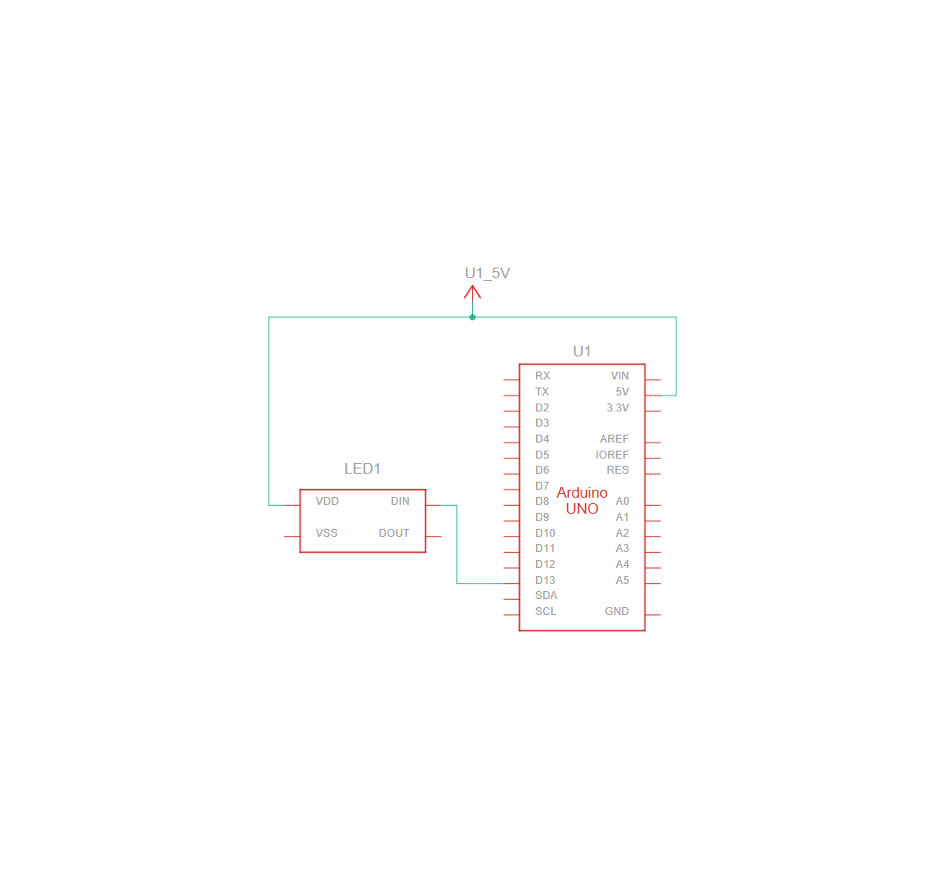
Diagram of what I made
This diagram does not however show the use of a breadboard and the way I used multiple LEDs but hooked the breadboard up to the Arduino to give the whole board power
It also does not have the antennae on it but I have hooked this up to the analogue pins on the Arduino
The GND and 5V wires are also on the breadboard.

Slide 10
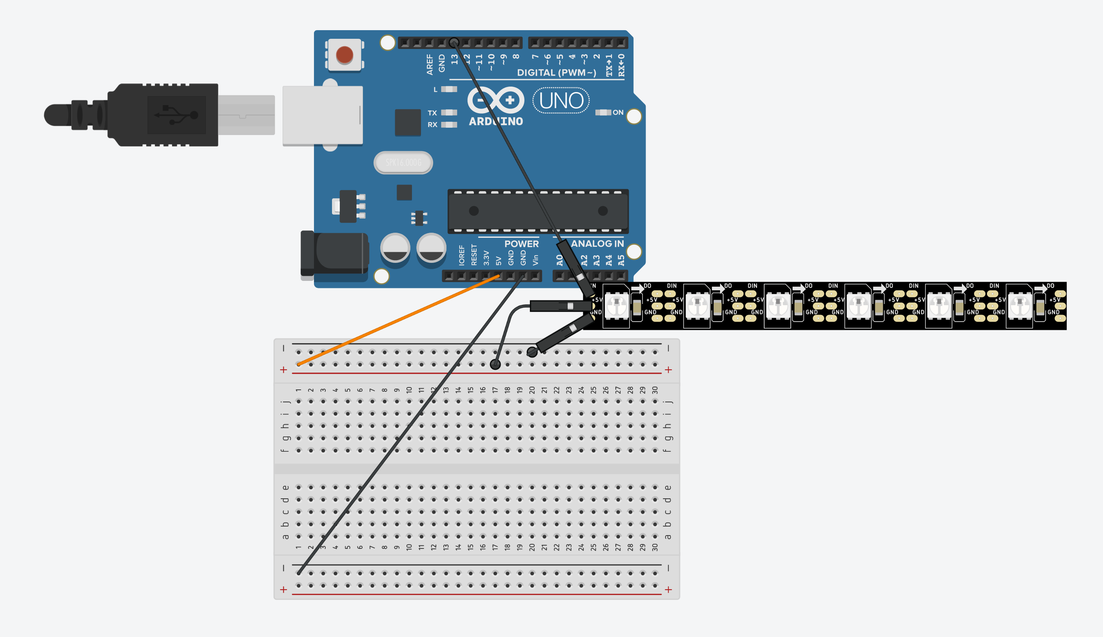
Picture of what I made minus the ariel
This is another representation of what I created.
I did the same thing multiple times with different lengths of ariel to test them and see the changes

Slide 11
Components used
Jumper wires
Addressable LEDs
Breadboard
Arduino UNO
Antennae – made from twisted pairs of wires out of network cable

Slide 12
Improvements
While this device does work, some improvements I would make would be to find a better working example and have more time to tinker with it, and have it doing more.

Slide 13
Code
int ledLights(int number){
int numLeds = 0;
if(number > 201 && number < 340){
numLeds = 1;
}
else if(number > 341 && number < 480){
numLeds = 2;
}
else if(number > 481 && number < 620){
numLeds = 3;
}
else if( number > 621 && number < 750){
numLeds = 4;
}
else if(number > 751 && number < 890){
numLeds = 5;
}
else if(number > 891){
numLeds = 6;
}
This code lets the strips know values and how many of each colour to show.
Red is high value and Blue is low value
Red is the base colour.
I like this code because it shows the project works the way I want it to without this there wouldn’t be much to show.
I have also used different lengths of aerial so in theory they should have different colours and amounts of lights at different times.

Slide 14
Summary
This was a fun, but stressful project to work on. Like a lot of things they sound good on paper but in practice they can be very different.
But I persevered and got it finished to present.
I will hopefully learn from my mistakes this time for the next project.

